Slide 1


Biophysical modeling for plant growth
A model for the evapotranspiration of the lettuce
Luca Ciarimboli
Lorenzo Citterio
Marianna Dell’Otto

Slide 2
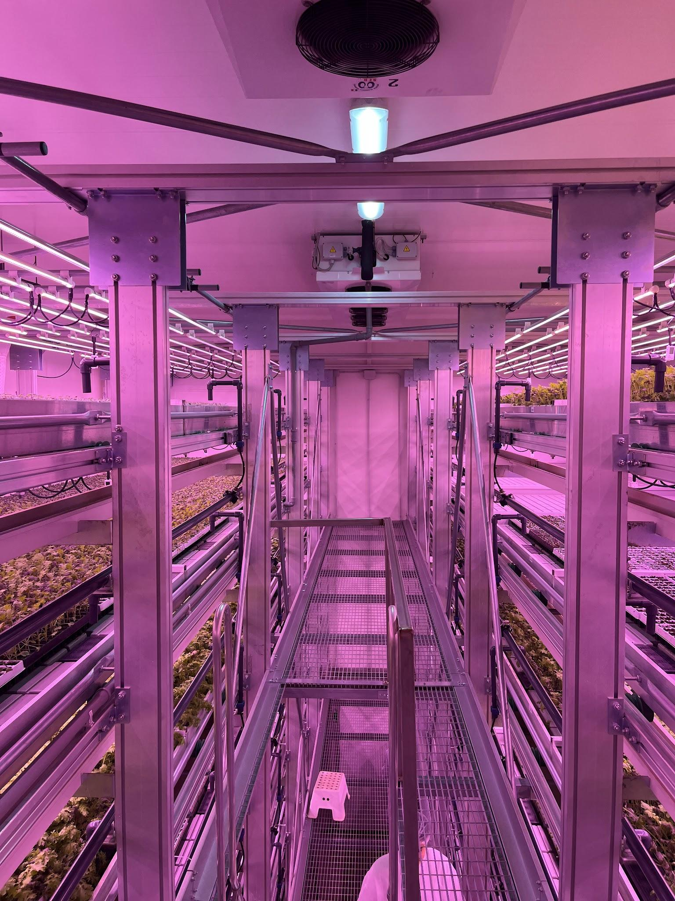
What is Agricola Moderna?
Agricola Moderna is a VERTICAL FARM
Vertically stacked crops
Controlled, protected environment
95% of water saved
98% of soil saved
No pesticides

Slide 3
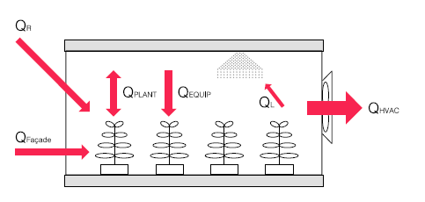
What still has to be improved?
Maximal optimization is crucial for economic sustainability
→
What is our goal?
To predict the mass of water released by crops due to evapotranspiration

Slide 4
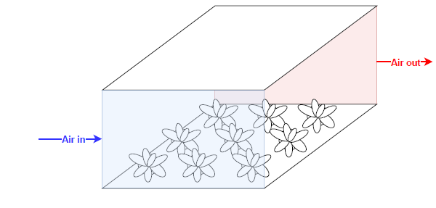
Action plan
Simplified cubic cell
NS + k-𝜺 model
Model for lettuce growth
FreeFem++ implementation
Simulations together with Agricola Moderna

Slide 5
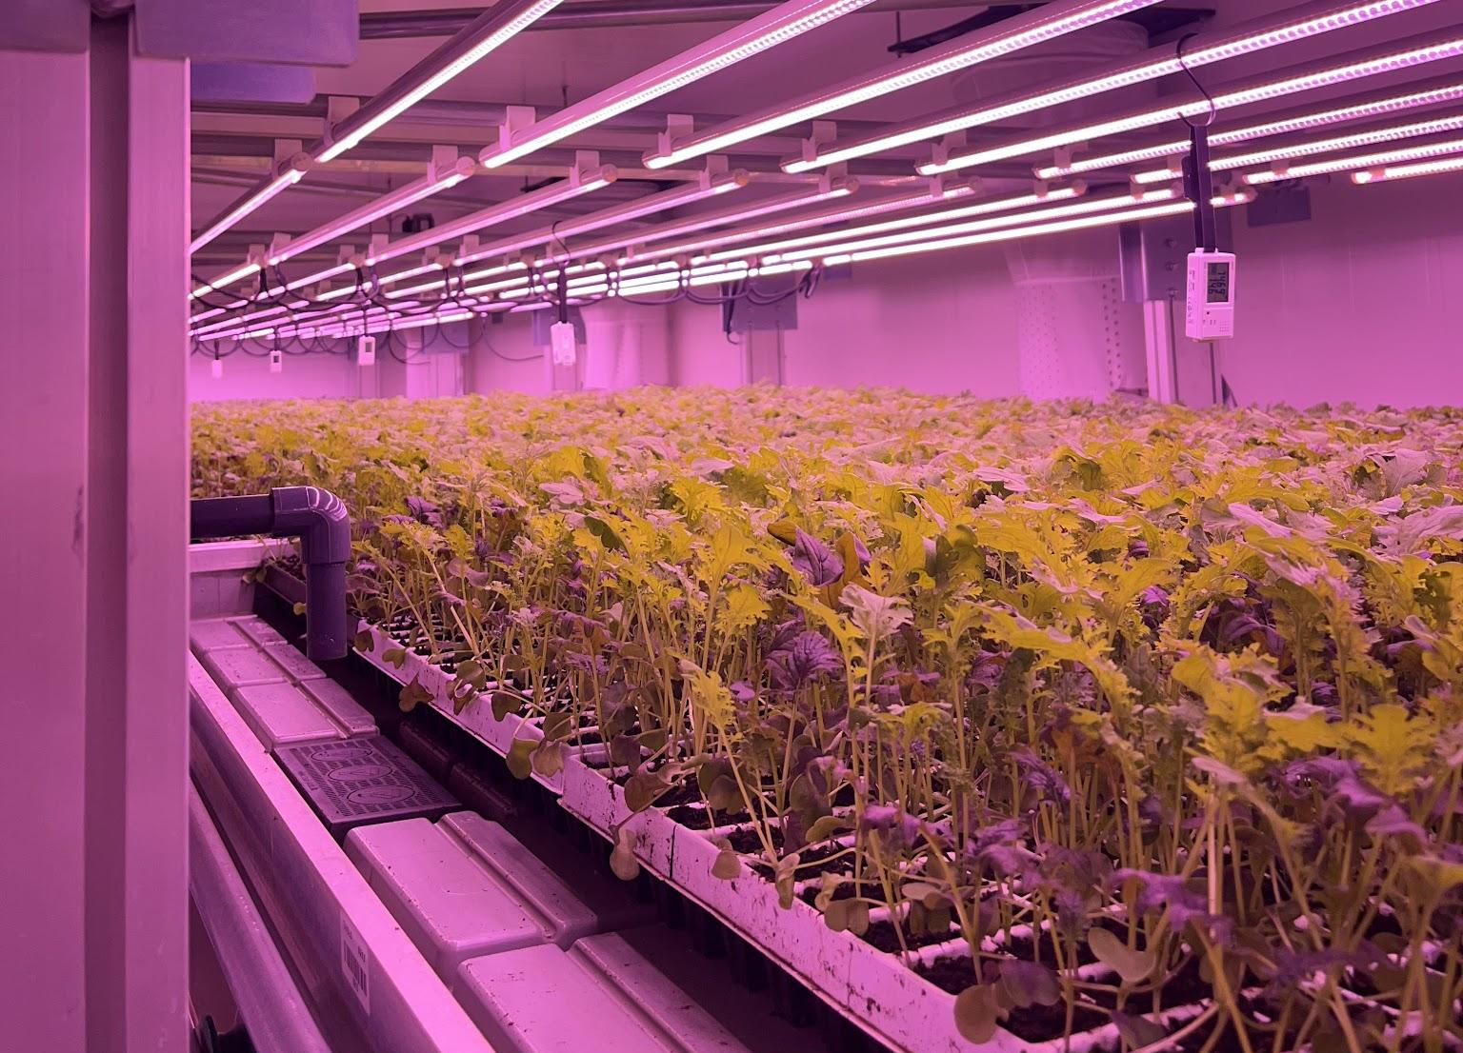
Thank you!

